Slide 1
Mylan Laboratories’ Proposed Merger with King Pharmaceutical
Audrey Tjahjono, Hitansha A V, Achal Shah

Slide 2
Overview of the Case
Mylan Laboratories
King Pharmaceuticals
Shareholders
Founded in 1961
In late 1980’s, the company aimed to diversify and the success of this strategy led to $1 billion sales in 2002
Net revenue was down 7% over the last 6 months, margins had fallen to 48.9%
On July 26,2004, Mylan Management announced a proposal to merge with King Pharmaceuticals
A contract manufacturer of prescription medicines founded in 1993
Acquired more than 50 branded prescription product lines
In early march 2003, king’s shares dropped 24%
In july 2003, the firm’s share is down from 97 cents to 74 cents per share
Carl Icahn (High River)
He labeled the deal “stupid”
Its hedge fund holds 9.8% of Mylan’s share
Richard Perry (Perry Capital)
Perry was in favor of the merger
Holds 9.9% of Mylan’s share and several million shares of King’s

Slide 3
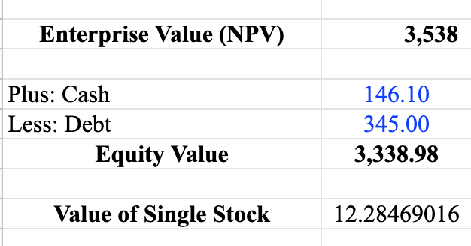
Whether the Merger creates value for Mylan and King
Whether it would be valuable for King
Valuation Model
King is under investigation by SEC for alleged Medicaid pricing valuation
King was suffering in cash and has more long term debt
Its value of a single stock is $12.3/share
Conclusion:
The merger would benefit King

Slide 4
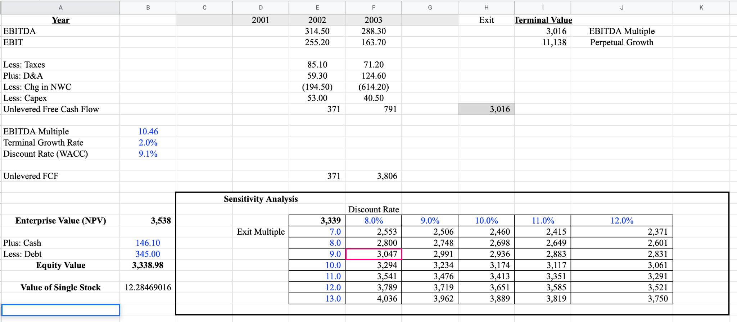
King’s DCF

Slide 5
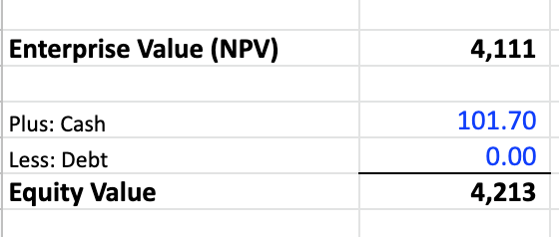
Whether the Merger creates value for Mylan and King
Whether it would be valuable for Mylan
Valuation Model
Mylan has approximately 101.7 million in cash, no debt
Its equity value is higher than King’s
King’s value of one single stock is $12.3. The price offered by Mylan is too high. Resulting in a premium of $4.4 of every share purchased by Mylan
Conclusion:
The deal is not good for Mylan

Slide 6
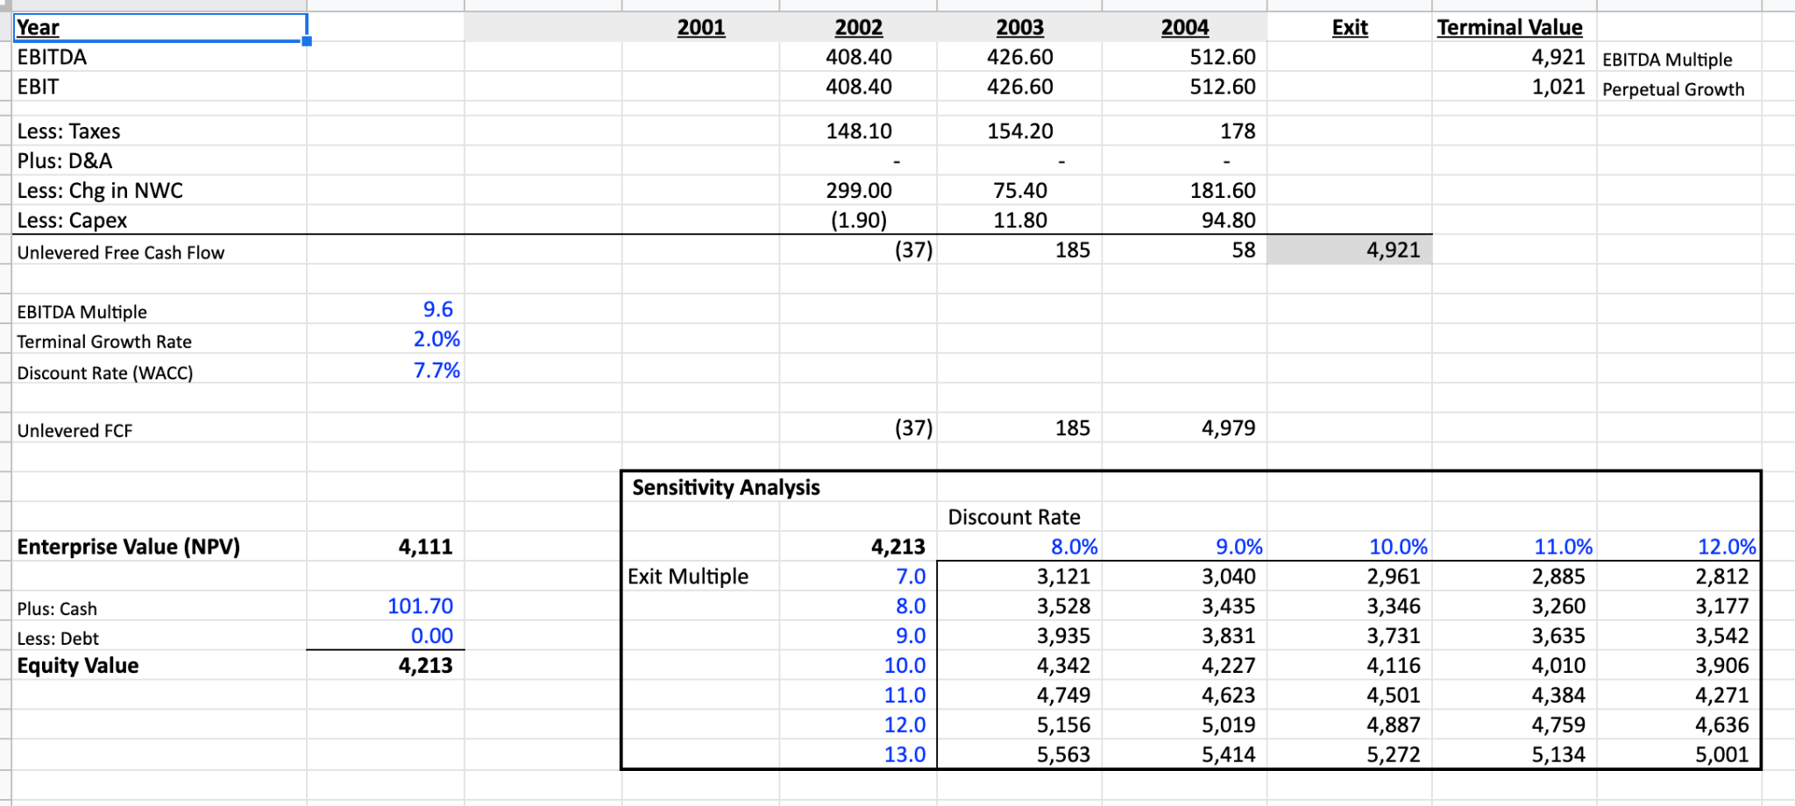
Mylan’s DCF

Slide 7
How should both companies vote for the merger?
Shareholders of Mylan: vote against
Shareholders of King: vote for

Slide 8
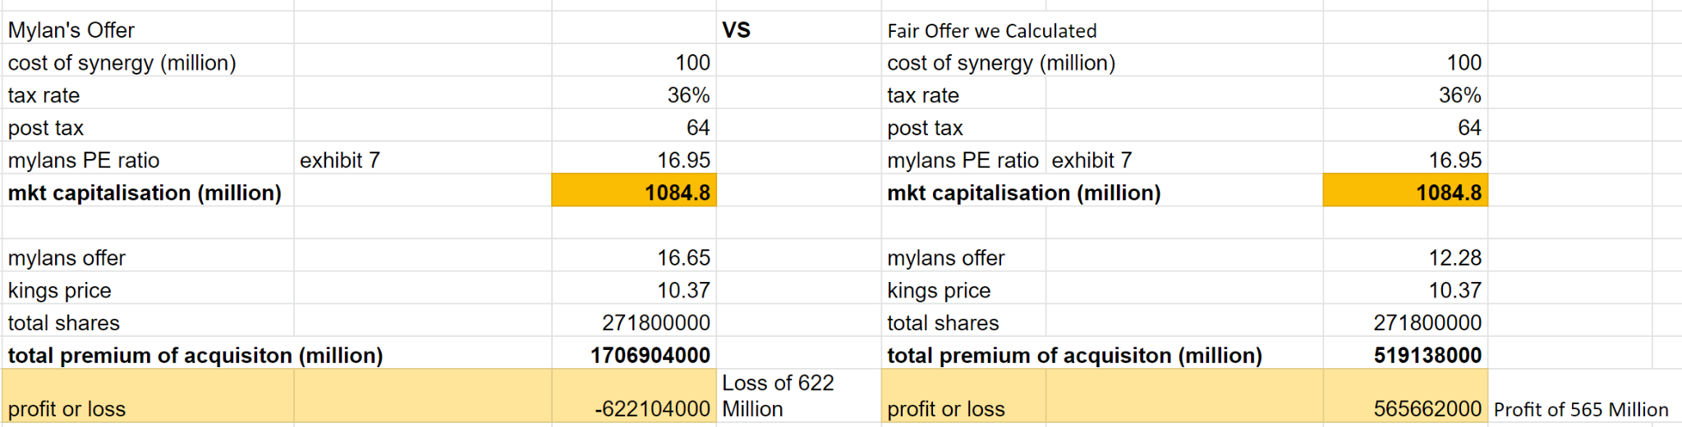
What is the value of anticipated synergies?

Slide 9
Why does it make sense that beta of Mylan is lower than beta of King?
Because the King’s equity is more volatile than Mylan’s equity.
“High risk-high return” principle : If the venture where investment is required has a high level of risk, the return required by the investor would also be very high to compensate the risk. In this case, we see that King has higher level of risk.
Mylan has more stable cash flow → reduced risk of bankruptcy → lower cost of capital

Slide 10
Is Mylan overpaying? Could undervaluation of King make up the difference?
If Mylan offers to pay $16.659 to acquire King then they are overpaying. Mylan would be paying a premium of about $6.52. This would also lead to loss of ~ $622 million in Synergies.
According to DCF calculation the Equity value of King is $3398.98 million and number of outstanding shares are 271.8 million. Therefore the value of stock is $12.28.
If Mylan and King agree to the deal on calculated fair value of $12.28 or lower, then undervaluation of King can make up the difference as this will result in positive synergies of about $565 million.

Slide 11
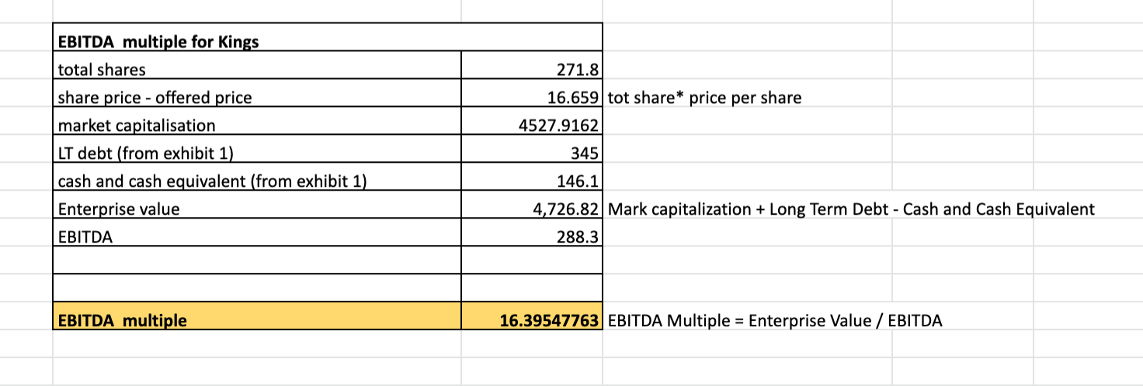
What would the EBITDA multiple be if the acquisition was consummated at the offered price?

Slide 12
“Empty Voting”
Background
Perry Capital had already established a large position in King’s stock.
As a result, Perry has a large economic stake in the transaction if the transaction is completed and a significant economic exposure if the transaction failed.
When Icahn acquired 9.8% of Mylan stock and publicly opposed the merger (Mylan is paying too much), Perry protects the investment by establishing 9.9% “empty voting” position, that insulated Perry from the economic risks of its ownership of Mylan stock. (ie; Perry hedged out its economic exp to mylan’s share price using derivatives)
Perry Capital is trying to achieve:

Slide 13
What is “empty voting”?
When do investors “empty vote”?
Why is it bad?
“Empty voting is a generic term embracing a variety of factual circumstances that result in a partial and often total separation of the right to vote at a shareholders' meeting from beneficial ownership of the shares on the meeting date”
Basically, a shareholder with reduced risk exposure retains its voting power and its influence in the company, but it does not bear the risk of negative returns.
When shareholders’ interests are no longer aligned with those of the corporations (in this case, Perry Capital to reduce the risk that was associated with an equity investment. ).
It undermines shareholder democracy and decouples risk and economic exposure. Not only it is harmful to financial markets and corporations, but It may also reduce the company’s share price.

Slide 14
Risk Management that Perry capital takes
Even though Perry throws costs to establish its “empty voting” position in Mylan, it would have benefited Mylan shareholders economically if they voted in favor of the merger and the transaction went through. Moreover, because Perry had no residual economic stake in Mylan, it did not have any economic exposure if Mylan was, in fact, over-paying for King.
In sum, Perry acquired its ~10% “empty voting” position in Mylan to protect its economic stake in completing the merger, no matter if the transaction was value creating or value diminishing for Mylan’s shareholders.

Slide 15
Thank You!

